Slide 1


Calculating age and choosing a SWYC form www.TheSWYC.org
Ellen C. Perrin, MD
R. Christopher Sheldrick, PhD
Kate Mattern, BA

Slide 2
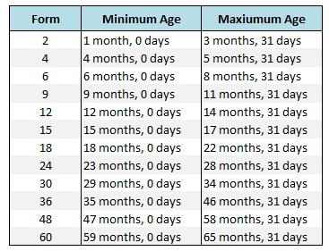
Calculate age
Need to know child’s exact age to select the appropriate SWYC form and score the Milestones
Once you’ve calculated it to find the correct form, write at the top to help with later Milestones scoring

Slide 3
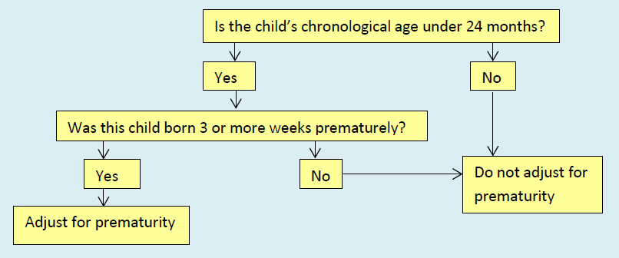
Calculate age

Slide 4


Two ways- electronic or pen and paper
Electronic calculation is much easier!
Downloadable Excel tool
Or in SWYC electronic builds
Pen and paper is tricky and can be
time-consuming

Slide 5
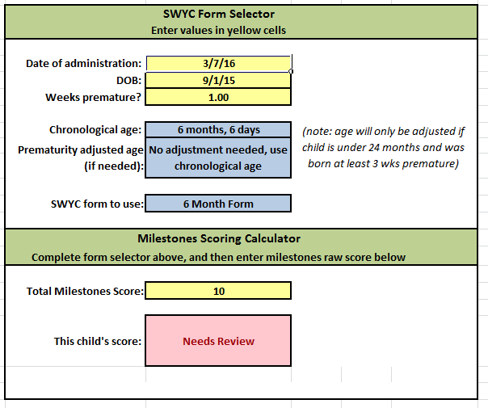
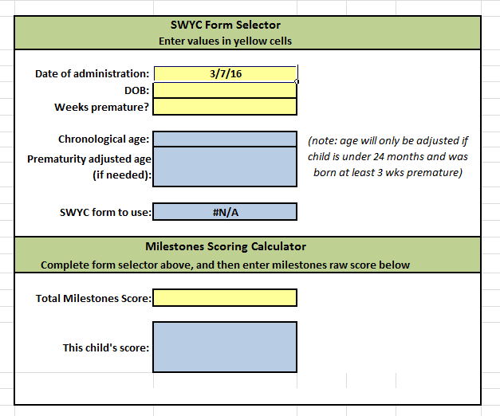
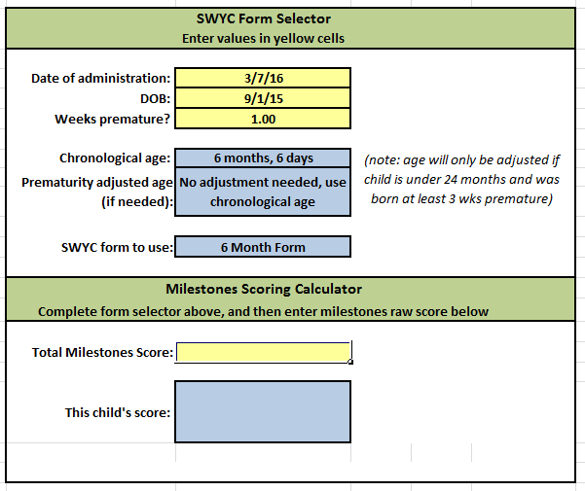
Excel tool
Download the SYWC Form and Milestones Calculator from www.theswyc.org
Enter the child’s DOB and weeks premature
The Excel sheet will calculate the child’s age and adjust for prematurity only when needed
It tell you what SWYC form to choose

Slide 6

Calculating age by hand: Example One
First, determine whether the child is below 2 years old. If so, ask the parent if the child was three or more weeks premature. In this example, the child wasn’t premature.
Write the date of screening in this order: year, month, and day.
Write the child’s birthday below it in the same order.
Subtract.
Year Month Day
Date
of
screen
2016
10
5
DOB
2013
6
2
3
4
3
3 years, 4 months, 3 days

Slide 7
Calculating age by hand: Example Two
First, determine whether you need to adjust for prematurity. In this example, the child wasn’t premature.
Year Month Day

Slide 8
Calculating age by hand: Example Two
Write the date of screening in this order: year, month, and day.
Write the child’s birthday below it in the same order.
Subtract. In this example, this math requires you to “carry.”
30 days are borrowed in the month column
12 months are borrowed in the year column.
Year Month Day
Date
of
screen
2015
21
9
35
2016
10
5
DOB
2013
12
8
2
9
27
2 years, 9 months, 27 days

Slide 9
Calculating age by hand: Example Three
First, determine whether the child is below 2 years old. If so, ask the parent if the child was three or more weeks premature.
The child in this example is under 2 and was born 5 weeks premature. So, we need to adjust the child’s age for prematurity.

Slide 10
Calculating age by hand: Example Three
Write the date of screening in this order: year, month, and day.
Write the child’s birthday below it in the same order.
Calculate the chronological age by subtracting.
Date
of
screen
Year Month Day
2016
12
10
DOB
2015
6
2
1
6
8

Slide 11
Calculating age by hand: Example Three
Now, convert the weeks premature into months and days (we are considering 4 weeks = 1 month).Write these numbers out below the chronological age that you just calculated
Subtract again.
Now you have a prematurity-adjusted age
Date
of
screen
Year Month Day
2016
12
10
DOB
2015
6
2
1
6
8
Prematurity
1
7
1
5
1
1 years, 5 months, 1 day

Slide 12
Calculating age by hand
Once you’ve calculated age by hand, you consult this chart or the top of the SWYC forms to find the appropriate form

Slide 13


